Slide 1
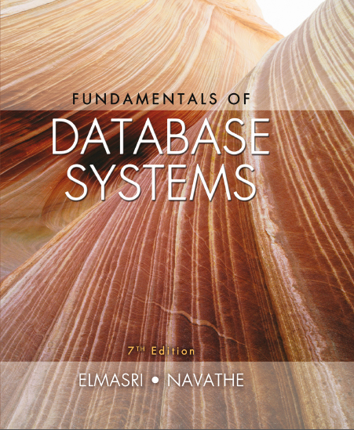
Fundamentals of Database Systems
Seventh Edition
Chapter 4
Enhanced Entity Relationship (E E R) Modeling
Copyright © 2016, 2011, 2007 Pearson Education, Inc. All Rights Reserved
Notes:
If this PowerPoint presentation contains mathematical equations, you may need to check that your computer has the following installed:
1) MathType Plugin
2) Math Player (free versions available)
3) NVDA Reader (free versions available)

Slide 2
Learning Objectives
4.1 E E R stands for Enhanced E R or Extended E R
4.2 E E R Model Concepts
4.2.1 Includes all modeling concepts of basic E R
4.2.2 Additional concepts:
4.2.2.1 subclasses/superclasses
4.2.2.2 specialization/generalization
4.2.2.3 categories (UNION types)
4.2.2.4 attribute and relationship inheritance
4.2.3 Constraints on Specialization/Generalization
4.3 The additional E E R concepts are used to model applications more completely and more accurately
4.3.1 E E R includes some object-oriented concepts, such as inheritance
4.4 Knowledge Representation and Ontology Concepts

Slide 3
Subclasses and Superclasses (1 of 5)
An entity type may have additional meaningful subgroupings of its entities
Example: EMPLOYEE may be further grouped into:
SECRETARY, ENGINEER, TECHNICIAN, …
Based on the EMPLOYEE’s Job
MANAGER
EMPLOYEEs who are managers (the role they play)
SALARIED_EMPLOYEE, HOURLY_EMPLOYEE
Based on the EMPLOYEE’s method of pay
E E R diagrams extend E R diagrams to represent these additional subgroupings, called subclasses or subtypes

Slide 4
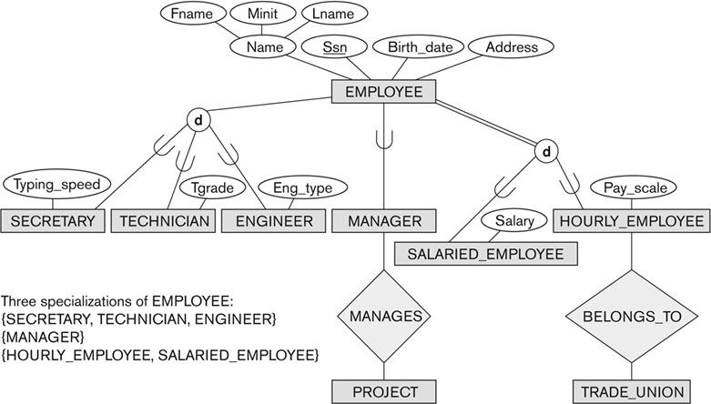
Subclasses and Superclasses (2 of 5)
Figure 4.1 E E R diagram notation to represent subclasses and specialization.

Slide 5
Subclasses and Superclasses (3 of 5)
Each of these subgroupings is a subset of EMPLOYEE entities
Each is called a subclass of EMPLOYEE
EMPLOYEE is the superclass for each of these subclasses
These are called superclass/subclass relationships:
EMPLOYEE/SECRETARY
EMPLOYEE/TECHNICIAN
EMPLOYEE/MANAGER
…

Slide 6
Subclasses and Superclasses (4 of 5)
These are also called I S-A relationships
SECRETARY I S-A EMPLOYEE, TECHNICIAN I S-A EMPLOYEE, ….
Note: An entity that is member of a subclass represents the same real-world entity as some member of the superclass:
The subclass member is the same entity in a distinct specific role
An entity cannot exist in the database merely by being a member of a subclass; it must also be a member of the superclass
A member of the superclass can be optionally included as a member of any number of its subclasses

Slide 7
Subclasses and Superclasses (5 of 5)
Examples:
A salaried employee who is also an engineer belongs to the two subclasses:
ENGINEER, and
SALARIED_EMPLOYEE
A salaried employee who is also an engineering manager belongs to the three subclasses:
MANAGER,
ENGINEER, and
SALARIED_EMPLOYEE
It is not necessary that every entity in a superclass be a member of some subclass

Slide 8
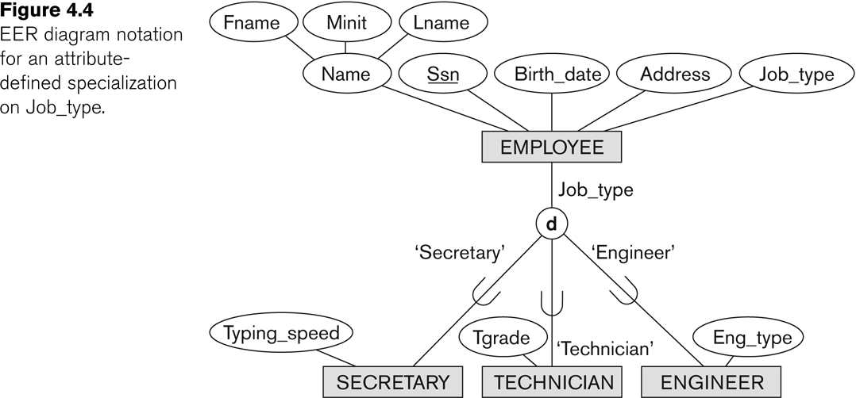
Representing Specialization in E E R Diagrams
Figure 4.4 E E R diagram notation for an attribute-defined specialization on Job_type.

Slide 9
Attribute Inheritance in Superclass / Subclass Relationships
An entity that is member of a subclass inherits
All attributes of the entity as a member of the superclass
All relationships of the entity as a member of the superclass
Example:
In the previous slide, SECRETARY (as well as TECHNICIAN and ENGINEER) inherit the attributes Name, S S N, …, from EMPLOYEE
Every SECRETARY entity will have values for the inherited attributes

Slide 10
Specialization (1 of 3)
Specialization is the process of defining a set of subclasses of a superclass
The set of subclasses is based upon some distinguishing characteristics of the entities in the superclass
Example: {SECRETARY, ENGINEER, TECHNICIAN} is a specialization of EMPLOYEE based upon job type.
Example: MANAGER is a specialization of EMPLOYEE based on the role the employee plays
May have several specializations of the same superclass

Slide 11
Specialization (2 of 3)
Example: Another specialization of EMPLOYEE based on method of pay is {SALARIED_EMPLOYEE, HOURLY_EMPLOYEE}.
Superclass/subclass relationships and specialization can be diagrammatically represented in E E R diagrams
Attributes of a subclass are called specific or local attributes.
For example, the attribute TypingSpeed of SECRETARY
The subclass can also participate in specific relationship types.
For example, a relationship BELONGS_TO of HOURLY_EMPLOYEE

Slide 12
Specialization (3 of 3)
Figure 4.1 E E R diagram notation to represent subclasses and specialization.

Slide 13
Generalization (1 of 2)
Generalization is the reverse of the specialization process
Several classes with common features are generalized into a superclass;
original classes become its subclasses
Example: CAR, TRUCK generalized into VEHICLE;
both CAR, TRUCK become subclasses of the superclass VEHICLE.
We can view {CAR, TRUCK} as a specialization of VEHICLE
Alternatively, we can view VEHICLE as a generalization of CAR and TRUCK

Slide 14
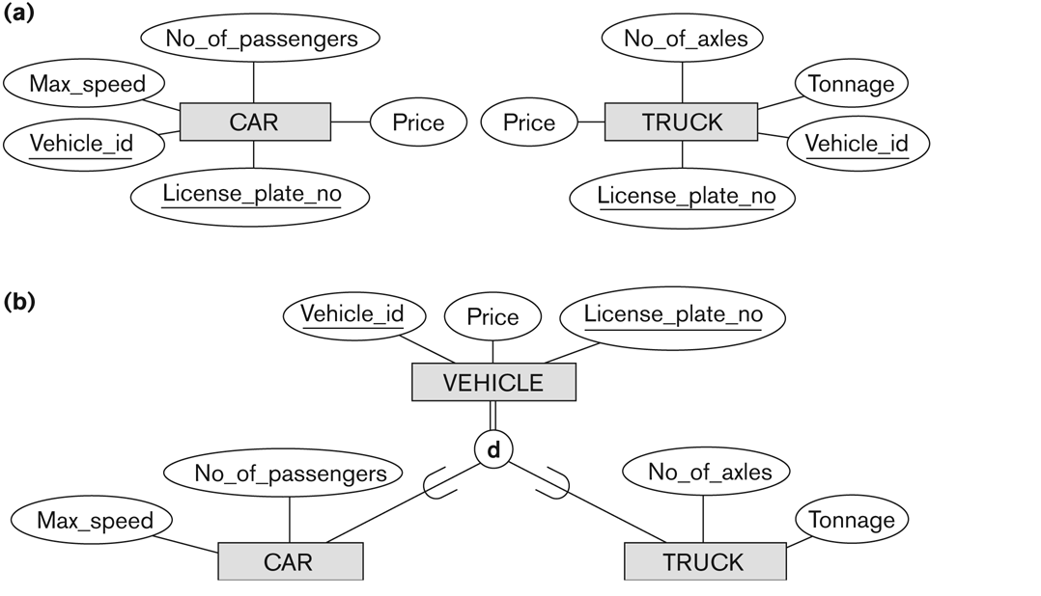
Generalization (2 of 2)
Figure 4.3 Generalization. (a) Two entity types, CAR and TRUCK. (b) Generalizing CAR and TRUCK into the superclass VEHICLE.

Slide 15
Generalization and Specialization (1 of 2)
Diagrammatic notations are sometimes used to distinguish between generalization and specialization
Arrow pointing to the generalized superclass represents a generalization
Arrows pointing to the specialized subclasses represent a specialization
We do not use this notation because it is often subjective as to which process is more appropriate for a particular situation
We advocate not drawing any arrows

Slide 16
Generalization and Specialization (2 of 2)
Data Modeling with Specialization and Generalization
A superclass or subclass represents a collection (or set or grouping) of entities
It also represents a particular type of entity
Shown in rectangles in E E R diagrams (as are entity types)
We can call all entity types (and their corresponding collections) classes, whether they are entity types, superclasses, or subclasses

Slide 17
Types of Specialization
Predicate-defined (or condition-defined) : based on some predicate. E.g., based on value of an attribute, say, Job-type, or Age.
Attribute-defined: shows the name of the attribute next to the line drawn from the superclass toward the subclasses (see Figure 4.1 (see slide 4 and 12))
User-defined: membership is defined by the user on an entity by entity basis

Slide 18
Constraints on Specialization and Generalization (1 of 6)
If we can determine exactly those entities that will become members of each subclass by a condition, the subclasses are called predicate-defined (or condition-defined) subclasses
Condition is a constraint that determines subclass members
Display a predicate-defined subclass by writing the predicate condition next to the line attaching the subclass to its superclass

Slide 19
Constraints on Specialization and Generalization (2 of 6)
If all subclasses in a specialization have membership condition on same attribute of the superclass, specialization is called an attribute-defined specialization
Attribute is called the defining attribute of the specialization
Example: JobType is the defining attribute of the specialization {SECRETARY, TECHNICIAN, ENGINEER} of EMPLOYEE
If no condition determines membership, the subclass is called user-defined
Membership in a subclass is determined by the database users by applying an operation to add an entity to the subclass
Membership in the subclass is specified individually for each entity in the superclass by the user

Slide 20
Displaying an Attribute-Defined Specialization in E E R diagrams
Figure 4.4 E E R diagram notation for an attribute-defined specialization on Job_type.

Slide 21
Constraints on Specialization and Generalization (3 of 6)
Two basic constraints can apply to a specialization/generalization:
Disjointness Constraint:
Completeness Constraint:

Slide 22
Constraints on Specialization and Generalization (4 of 6)
Disjointness Constraint:
Specifies that the subclasses of the specialization must be disjoint:
an entity can be a member of at most one of the subclasses of the specialization
Specified by d in E E R diagram
If not disjoint, specialization is overlapping:
that is the same entity may be a member of more than one subclass of the specialization
Specified by o in E E R diagram

Slide 23
Constraints on Specialization and Generalization (5 of 6)
Completeness (Exhaustiveness) Constraint:
Total specifies that every entity in the superclass must be a member of some subclass in the specialization/generalization
Shown in E E R diagrams by a double line
Partial allows an entity not to belong to any of the subclasses
Shown in E E R diagrams by a single line

Slide 24
Constraints on Specialization and Generalization (6 of 6)
Hence, we have four types of specialization/generalization:
Disjoint, total
Disjoint, partial
Overlapping, total
Overlapping, partial
Note: Generalization usually is total because the superclass is derived from the subclasses.

Slide 25
Example of Disjoint Partial Specialization
Figure 4.4 E E R diagram notation for an attribute-defined specialization on Job_type.

Slide 26
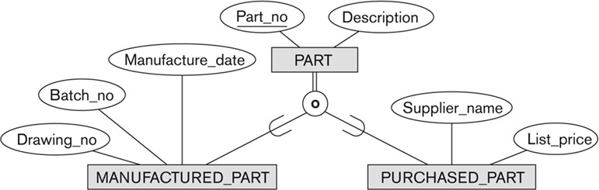
Example of Overlapping Total Specialization
Figure 4.5 E E R diagram notation for an overlapping (nondisjoint) specialization.

Slide 27
Specialization/Generalization Hierarchies, Lattices & Shared Subclasses (1 of 3)
A subclass may itself have further subclasses specified on it
forms a hierarchy or a lattice
Hierarchy has a constraint that every subclass has only one superclass (called single inheritance); this is basically a tree structure
In a lattice, a subclass can be subclass of more than one superclass (called multiple inheritance)

Slide 28
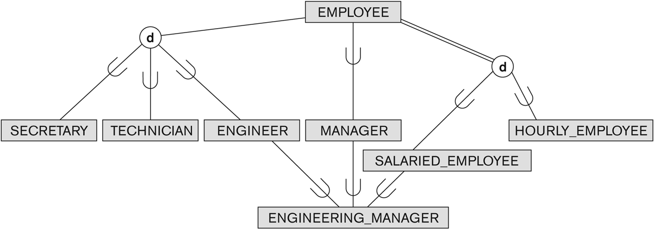
Shared Subclass “Engineering_Manager”
Figure 4.6 A specialization lattice with shared subclass ENGINEERING_MANAGER.

Slide 29
Specialization/Generalization Hierarchies, Lattices & Shared Subclasses (2 of 3)
In a lattice or hierarchy, a subclass inherits attributes not only of its direct superclass, but also of all its predecessor superclasses
A subclass with more than one superclass is called a shared subclass (multiple inheritance)
Can have:
specialization hierarchies or lattices, or
generalization hierarchies or lattices,
depending on how they were derived
We just use specialization (to stand for the end result of either specialization or generalization)

Slide 30
Specialization/Generalization Hierarchies, Lattices & Shared Subclasses (3 of 3)
In specialization, start with an entity type and then define subclasses of the entity type by successive specialization
called a top down conceptual refinement process
In generalization, start with many entity types and generalize those that have common properties
Called a bottom up conceptual synthesis process
In practice, a combination of both processes is usually employed

Slide 31
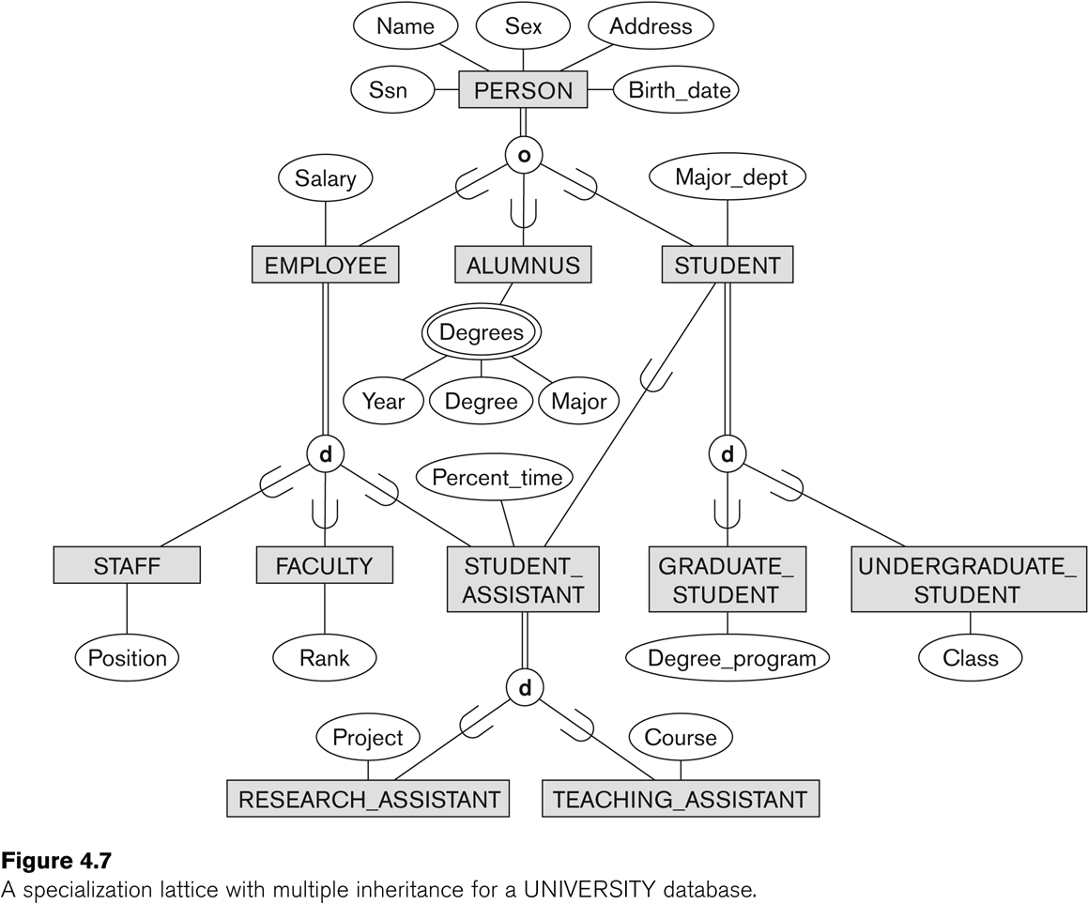
Specialization / Generalization Lattice Example (UNIVERSITY)
Figure 4.7 A specialization lattice with multiple inheritance for a UNIVERSITY database.

Slide 32
Categories (UNION TYPES) (1 of 2)
All of the superclass/subclass relationships we have seen thus far have a single superclass
A shared subclass is a subclass in:
more than one distinct superclass/subclass relationships
each relationships has a single superclass
shared subclass leads to multiple inheritance
In some cases, we need to model a single superclass/subclass relationship with more than one superclass
Superclasses can represent different entity types
Such a subclass is called a category or UNION TYPE

Slide 33
Categories (UNION TYPES) (2 of 2)
Example: In a database for vehicle registration, a vehicle owner can be a PERSON, a BANK (holding a lien on a vehicle) or a COMPANY.
A category (UNION type) called OWNER is created to represent a subset of the union of the three superclasses COMPANY, BANK, and PERSON
A category member must exist in at least one (typically just one) of its superclasses
Difference from shared subclass, which is a:
subset of the intersection of its superclasses
shared subclass member must exist in all of its superclasses

Slide 34
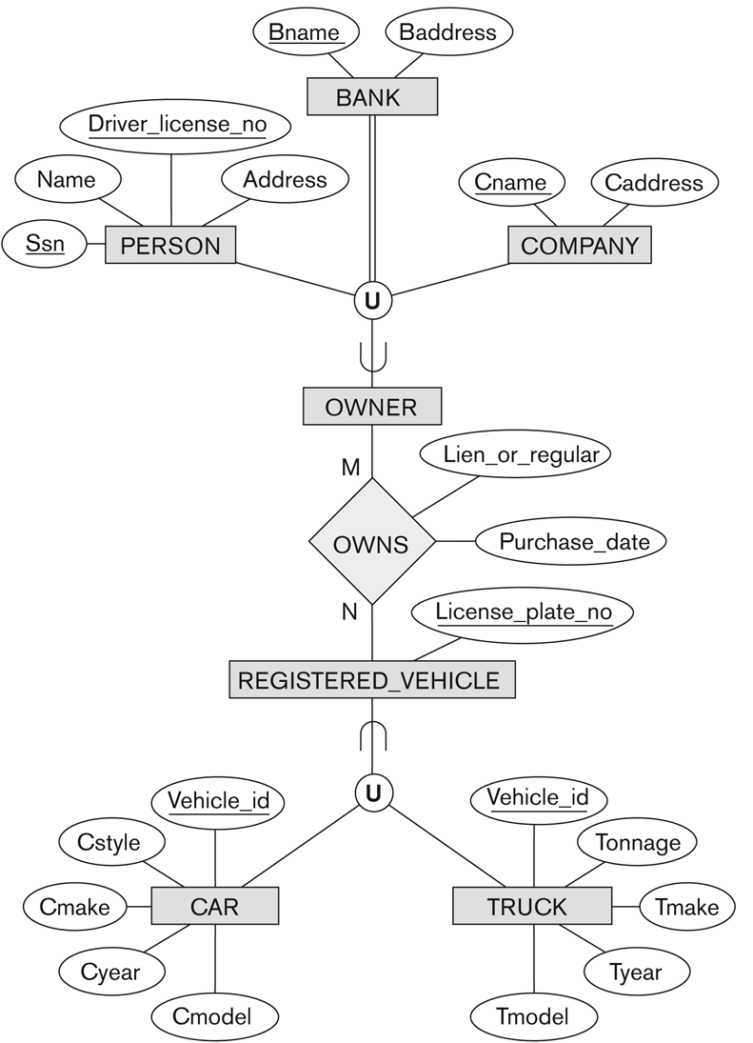
Two Categories (UNION Types): OWNER, REGISTERED_VEHICLE
Figure 4.8 Two categories (union types): OWNER and REGISTERED_VEHICLE.

Slide 35
Formal Definitions of E E R Model (1 of 4)
Class C:
A type of entity with a corresponding set of entities:
could be entity type, subclass, superclass, or category
Note: The definition of relationship type in E R/E E R should have ‘entity type’ replaced with ‘class’ to allow relationships among classes in general
Subclass S is a class whose:
Type inherits all the attributes and relationship of a class C
Set of entities must always be a subset of the set of entities of the other class C
C is called the superclass of S
A superclass/subclass relationship exists between S and C

Slide 36
Formal Definitions of E E R Model (2 of 4)
Specialization
is a set of subclasses
with same superclass G; hence, G/S i is a superclass relationship
G is called a generalization of the subclasses
Z is total if we always have:
Otherwise, Z is partial.
Z is disjoint if we always have:
Otherwise, Z is overlapping.

Slide 37
Formal Definitions of E E R Model (3 of 4)
Subclass S of C is predicate defined if predicate (condition) p on attributes of C is used to specify membership in S;
that is, S = C[p], where C[p] is the set of entities in C that satisfy condition p
A subclass not defined by a predicate is called user-defined
Attribute-defined specialization: if a predicate A = c i (where A is an attribute of G and ci is a constant value from the domain of A) is used to specify membership in each subclass S i in Z
Note: If
and A is single-valued, then the
attribute-defined specialization will be disjoint.

Slide 38
Formal Definitions of E E R Model (4 of 4)
Category or UNION type T
A class that is a subset of the union of n defining superclasses
Can have a predicate pi on the attributes of D i to specify entities of D i that are members of T.
If a predicate is specified on every

Slide 39
Alternative Diagrammatic Notations (1 of 2)
E R/E E R diagrams are a specific notation for displaying the concepts of the model diagrammatically
D B design tools use many alternative notations for the same or similar concepts
One popular alternative notation uses U M L class diagrams
see next slides for U M L class diagrams and other alternative notations

Slide 40
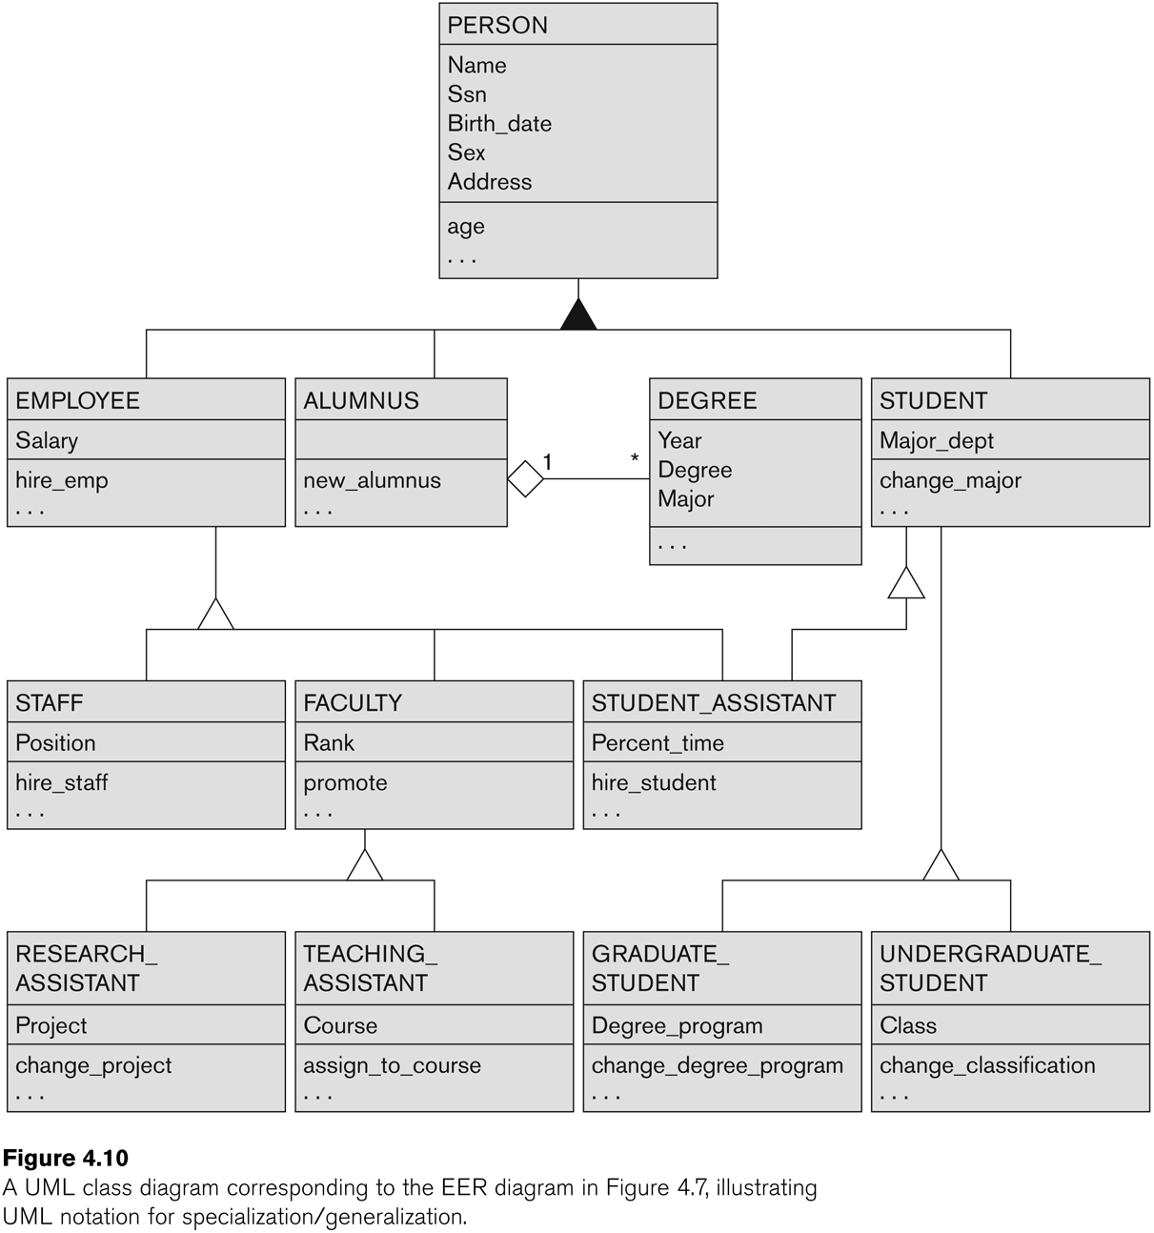
U M L Example for Displaying Specialization / Generalization
Figure 4.10 A U M L class diagram corresponding to the E E R diagram in Figure 4.7, illustrating U M L notation for specialization/generalization.

Slide 41
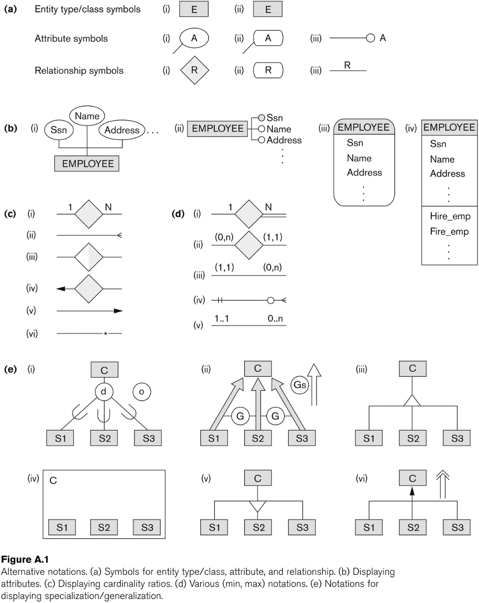
Alternative Diagrammatic Notations (2 of 2)
Figure A.1 Alternative notations. (a) Symbols for entity type/class, attribute, and relationship. (b) Displaying attributes. (c) Displaying cardinality ratios. (d) Various (min, max) notations. (e) Notations for displaying specialization/generalization.

Slide 42
Knowledge Representation (K R) (1 of 3)
Deals with modeling and representing a certain domain of knowledge.
Typically done by using some formal model of representation and by creating an Ontology
An ontology for a specific domain of interest describes a set of concepts and interrelationships among those concepts
An Ontology serves as a “schema” which enables interpretation of the knowledge in a “knowledge-base”

Slide 43
Knowledge Representation (K R) (2 of 3)
COMMON FEATURES between K R and Data Models:
Both use similar set of abstractions – classification, aggregation, generalization, and identification.
Both provide concepts, relationships, constraints, operations and languages to represent knowledge and model data
DIFFERENCES:
K R has broader scope: tries to deal with missing and incomplete knowledge, default and common-sense knowledge etc.

Slide 44
Knowledge Representation (K R) (3 of 3)
DIFFERENCES:
K R schemes typically include rules and reasoning mechanisms for inferencing
Most K R techniques involve data and metadata. In data modeling, these are treated separately
K R is used in conjunction with artificial intelligence systems to do decision support applications
For more details on spatial, temporal and multimedia data modeling, see Chapter 26. For details on use of Ontologies see Sections 27.4.3 and 27.7.4.

Slide 45
General Basis for Conceptual Modeling
TYPES OF DATA ABSTRACTIONS
CLASSIFICATION and INSTANTIATION
AGGREGATION and ASSOCIATION (relationships)
GENERALIZATION and SPECIALIZATION
IDENTIFICATION
CONSTRAINTS
CARDINALITY (Min and Max)
COVERAGE (Total versus Partial, and Exclusive (Disjoint) versus Overlapping)

Slide 46
Ontologies
Use conceptual modeling and other tools to develop “a specification of a conceptualization”
Specification refers to the language and vocabulary (data model concepts) used
Conceptualization refers to the description (schema) of the concepts of a particular field of knowledge and the relationships among these concepts
Many medical, scientific, and engineering ontologies are being developed as a means of standardizing concepts and terminology

Slide 47
Summary
Introduced the E E R model concepts
Class/subclass relationships
Specialization and generalization
Inheritance
Constraints on E E R schemas
These augment the basic E R model concepts introduced in Chapter 3
E E R diagrams and alternative notations were presented
Knowledge Representation and Ontologies were introduced and compared with Data Modeling

Slide 48

Copyright

